Slide 1

Linked Lists, Singly Linked List
Data Structure | Introduction to Data Structure
Course: Data Structure | Chapter: Introduction to Data Structure | Program: Bachelor of Engineering
DISCOVER · LEARN · EMPOWER
Notes:
Welcome everyone to today's lecture on Data Structures. We are focusing on the fundamental concept of Linked Lists, specifically the Singly Linked List. This topic is crucial for understanding dynamic memory allocation in C programming. Remember, our motto at Chandigarh University is to Discover, Learn, and Empower through technology.

Slide 2
Course Outcomes
SLIDE 2 / 10
Course Outcome
CO | BT LEVEL | DESCRIPTION
CO1 | BT1 | Understand and apply basic data structures, algorithms, complexity analysis, ADTs, arrays and linked lists.
CO2 | BT2 | Apply and implement stacks and queues in problem-solving.
CO3 | BT3 | Analyse and apply searching, sorting, and hashing techniques.
CO4 | BT4 | Construct and apply tree structures and traversal techniques.
CO5 | BT5 | Represent and solve graph problems using DFS, BFS, and graph algorithms.
Chandigarh University
2 / 10
Notes:
Today's lecture directly supports our Course Outcomes. While we focus on Linked Lists, this structure is the foundation for implementing stacks and queues mentioned in CO2. Furthermore, understanding how to traverse a list is essential for the searching techniques outlined in CO3. These outcomes ensure you can apply these concepts to real-world problem-solving scenarios.

Slide 3
Learning Objectives
SLIDE 3 / 10
Learning Outcomes
1
Define the concept of a Linked List and its dynamic nature.
2
Describe the structure of a node containing data and a link.
3
Differentiate between a Singly Linked List and other list types.
4
Explain the process of inserting and deleting nodes in a list.
Chandigarh University
3 / 10
Notes:
By the end of this session, you will be able to define a Linked List clearly. You will understand how a node is structured with data and a pointer. We will also differentiate this from arrays and other list types. Finally, you will grasp the logic behind inserting and deleting elements dynamically.

Slide 4
Lecture
SLIDE 4 / 10
Definition of Linked List
1
A Linked List is a linear collection of data elements called nodes.
2
Each node contains data and a reference to the next node in sequence.
3
Unlike arrays, nodes are not stored in contiguous memory locations.
4
The list starts with a head pointer pointing to the first node.
5
The last node points to null to indicate the end of the list.
Chandigarh University
4 / 10
Notes:
Think of a Linked List as a treasure hunt where each clue leads to the next location. Unlike an array where items sit side-by-side, these nodes can be scattered in memory. The head pointer is like your starting point, and the null pointer marks the final destination. This structure allows for flexible sizing without pre-allocation.

Slide 5
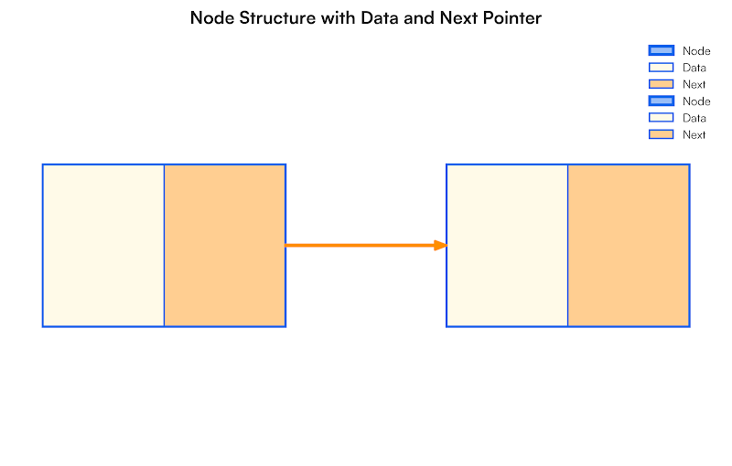
Lecture
SLIDE 5 / 10
Structure of a Node
1
A node consists of two distinct fields: data and link.
2
The data field stores the actual value or information being processed.
3
The link field stores the memory address of the subsequent node.
4
In a Singly Linked List, the link points only to the next node.
5
The structure definition in C uses a struct to combine these fields.
Source: lh3.googleusercontent.com
Chandigarh University
5 / 10
Notes:
Let's look closely at the building block, which is the node. It has two parts: the data field holding your integer or character, and the link field holding the address. In a Singly Linked List, this link is unidirectional, pointing only forward. You define this using a C struct, which groups these two variables together logically.

Slide 6
Lecture
SLIDE 6 / 10
Singly Linked List Characteristics
1
Traversal is possible only in the forward direction from head to tail.
2
Memory allocation is dynamic, growing as new nodes are added.
3
No fixed size limit exists, constrained only by available system memory.
4
Accessing a specific element requires sequential traversal from the head.
5
Insertion and deletion are efficient as they do not require shifting.
Chandigarh University
6 / 10
Notes:
The key characteristic here is the unidirectional flow; you can only move forward. This means if you need the third element, you must start from the beginning and count. However, this flexibility allows us to add or remove items without shifting the entire array. It is ideal for scenarios where the data size changes frequently.

Slide 7
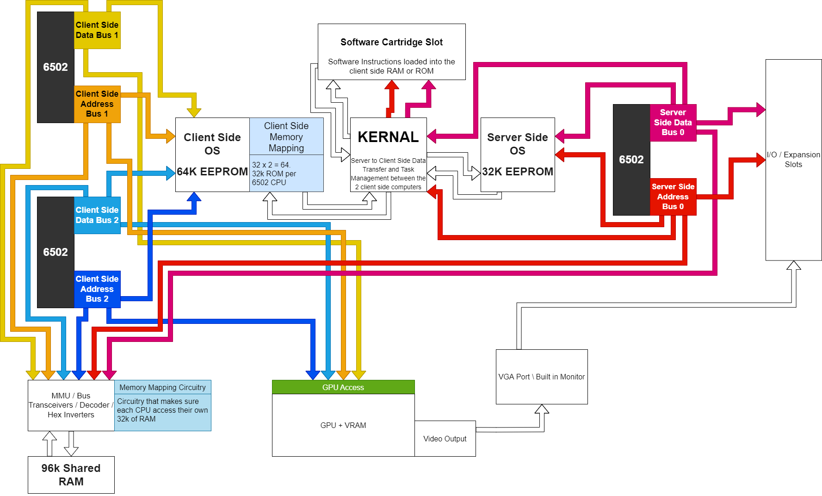
Lecture
SLIDE 7 / 10
Memory Allocation Example
1
Node A is allocated at memory address 1000 with data value 10.
2
Node B is allocated at memory address 2500 with data value 20.
3
Node A link field stores the address 2500 to point to Node B.
4
Node B link field stores null (0) to indicate the end of list.
5
Total memory used is the sum of individual node sizes in heap.
Source: i.redd.it
Chandigarh University
7 / 10
Notes:
Consider a concrete example where we allocate two nodes. Node A sits at address 1000 holding the number 10. Node B sits at address 2500 holding the number 20. The link in Node A points to 2500, creating the chain. Node B points to null, signaling that the list ends there. This demonstrates how non-contiguous memory forms a logical sequence.

Slide 8
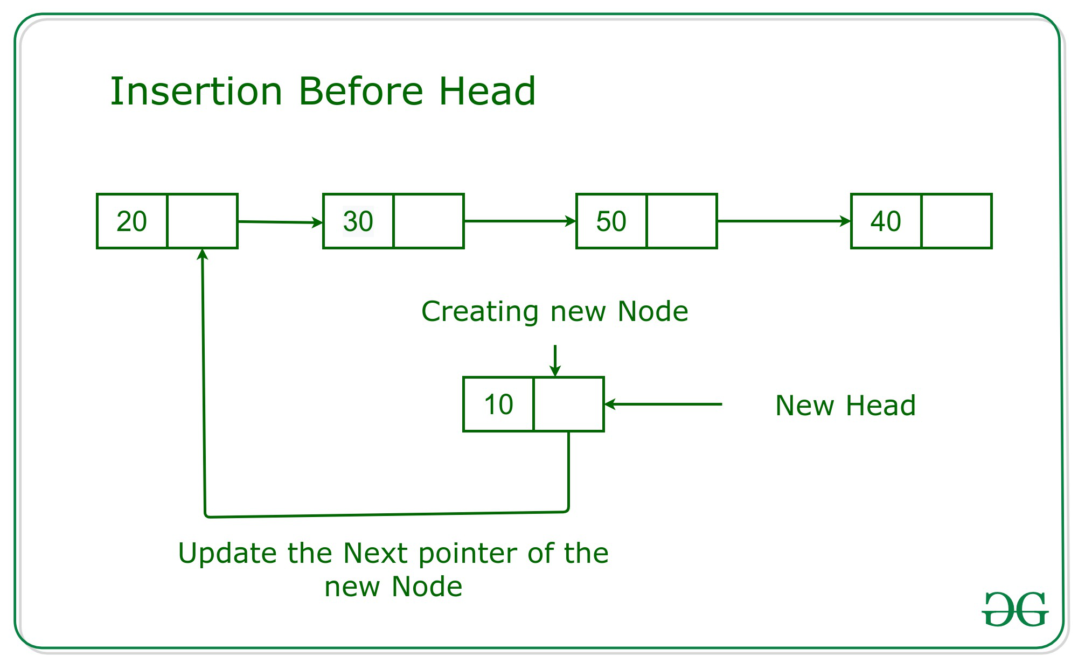
Lecture
SLIDE 8 / 10
Insertion Operation Logic
1
To insert a node, first allocate memory for the new node dynamically.
2
Update the link of the new node to point to the next existing node.
3
Update the link of the previous node to point to the new node.
4
If inserting at the head, update the head pointer to the new node.
5
This operation maintains the sequential order without moving existing data.
Source: media.geeksforgeeks.org
Chandigarh University
8 / 10
Notes:
Insertion involves a few precise pointer updates. First, you create the new node and point it to the node that currently follows the insertion point. Then, you update the previous node to point to this new node. If you are adding to the front, the head pointer simply moves to the new node. This avoids the costly shifting required in arrays.

Slide 9
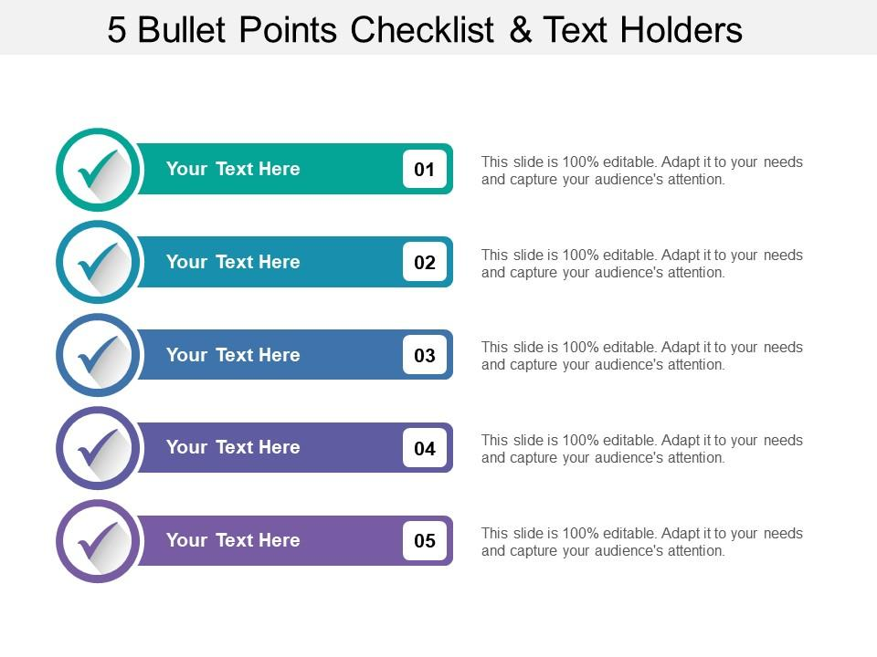
Lecture
SLIDE 9 / 10
Key Takeaways
1
Linked Lists use nodes with data and pointers for non-contiguous storage.
2
Singly Linked Lists allow traversal in only one direction from head to tail.
3
Dynamic memory allocation enables flexible list sizing during program execution.
4
Insertion and deletion are efficient as they only require pointer updates.
5
Sequential access is required to reach specific elements within the list.
Source: www.slideteam.net
Chandigarh University
9 / 10
Notes:
To summarize, remember that Linked Lists are dynamic and non-contiguous. The Singly Linked List is unidirectional, meaning you can only move forward. This structure makes insertion and deletion very efficient compared to arrays. However, you must traverse sequentially to access specific elements. These points form the core of your understanding for this chapter.

Slide 10
Lecture
SLIDE 10 / 10
References
DATA STRUCTURES
A Pseudocode Approach with C — Gilberg, Forouzan
• Data Structures — Lipschutz
• Data Structure Using C — AK Sharma
• C and Data structure — P. S. Deshpandey
Chandigarh University
10 / 10
Notes:
For further reading and deeper understanding, please refer to the listed textbooks. Gilberg and Forouzan provide excellent pseudocode approaches. Lipschutz offers a comprehensive theoretical background. Sharma and Deshpandey are excellent resources for C-specific implementations. These books will support your learning beyond this lecture.

